Slide 1

Department of Computer Science and Engineering
TITLE OF THE PROJECT
Pre-Owned Car Price Prediction Via Cross-Validated Meta Ensembles and Feature Composites
PRESENTED BY
GARIKAPATI AISHWARYA (22471A05F6)
PAGADALA SIRISHA (22471A05J5)
KURAPATI ANUSHA (22471A05G7)
Under the Guidance of,
Dr. Yamani Chandana M.Tech.,
Assistant Professor,
Department of Computer Science and Engineering,
Narasaraopeta Engineering College (Autonomous),
Narasaraopet- 522601.
05-12-2025
Review No.2 Batch No. CG4 Department of CSE
1
Notes:
1

Slide 2
OUTLINE
Abstract
Introduction
Literature Survey
Research Gaps
Problem Statement
Objectives
Flow Diagram
Methodology
Implementation
Results and Analysis
Conclusion & Future Scope
References
Question and Answers
Acknowledgements
05-12-2025
Review No.2 Batch No. CG4 Department of CSE
2

Slide 3
ABSTRACT
In this study we present a machine learning-based methodology to the assessment of pre-owned car prices in the Indian automotive market. We used a Kaggle provided used cars dataset of over 5,000 vehicle listings to which we applied domain relevant features and we also went over a number of regression methods which included Decision Tree, Random Forest, XGBoost, CatBoost as well as a stacked-ensemble model.Comprehensive data preparation was done which included the removal of outlying values using Interquartile Range, we transformed categorical attributes and also created new features like price-per-kilometer and horse-power-to-age ratio. Also we did model optimization via Grid Search with cross-validation to guarantee stability and performance.Among the evaluated models the best performance was seen in the stacked ensemble (which included Ridge Regression, XGBoost, and LightGBM) that put out an R² of 0.9886, RMSE of 1.79, and MAE of 0.90 Lakhs.CatBoost also performed very strongly on its own with an R² of 0.9848.For a real-world deployment we put in place a Flask based web service for price prediction. This solution which goes beyond the auto industry by helping dealers set competitive prices, we also provide price transparency for the buyers, we aid financial institutions in their risk assessment and we also enable e-marketplaces to put in place intelligent valuation tools.Overall we see that machine learning greatly improves the accuracy, reliability and access of used car valuations in today’s ever changing auto market.
05-12-2025
Review No.2 Batch No. CG4 Department of CSE
3

Slide 4
INTRODUCTION
Accurate pricing of used cars in India is challenging due to diverse attributes and dynamic market trends.
Traditional manual or rule-based valuation methods are inconsistent and prone to human bias.
A hybrid ML framework using Random Forest, XGBoost, CatBoost, and a Stacked Ensemble (Ridge + XGBoost + LightGBM) is proposed for precise prediction.
With advanced preprocessing, feature engineering, and cross-validation, the model achieves R² = 0.9886, ensuring reliable, real-time valuation across car segments.
05-12-2025
Review No.2 Batch No. CG4 Department of CSE
4

Slide 5
LITERATURE SURVEY
No | Title | Author | Journal Name & Year | Methodology Adapted | Key Findings | Gaps
1 | Machine Learning for Predicting Used Car Resale Prices Using Granular Vehicle Equipment Information | S. Bergmann, S. Feuerriegel | Expert Systems with Applications, 2025 | Applied Gradient Boosting on detailed vehicle feature data for price estimation. | Achieved high predictive accuracy using granular car attributes. | Limited regional adaptability and lack of real-time testing.
2 | Car Price Prediction Using Machine Learning | M. Ahmad et al. | IEEE I2CT Conference, 2024 | Used Decision Tree, Random Forest, and Linear Regression on Kaggle car dataset. | Achieved ~92% accuracy in structured car data prediction. | No feature engineering or cross-validation for robustness.
3 | Second-Hand Car Price Prediction: A Hybrid Model Integrating ML and Metaheuristic Optimization | M. T. H. Bejani et al. | Expert Systems with Applications, 2024 | Combined ML regressors with metaheuristic tuning for optimized regression. | Improved R² and reduced RMSE compared to base ML models. | High computational cost and not localized to Indian market.
05-12-2025
Review No.2 Batch No. CG4 Department of CSE
5

Slide 6
LITERATURE SURVEY
No | Title | Author(s) | Journal Name & Year | Methodology Adapted | Key Findings | Gaps
4 | Accurate Price Prediction of Used Cars Using Machine Learning Models | Vemula Venugopal, Shaik Haseena | IJERST Journal, 2025 | Compared ensemble regressors like XGBoost, and Random Forest. | Achieved R² ≈ 0.97 showing strong ensemble performance. | Lacked advanced preprocessing and interpretability study.
5 | ProbSAINT: Probabilistic Tabular Regression for Used Car Pricing | K. Madhusudhanan, A. Mishra, A. Agarwal | arXiv preprint, 2024 | Proposed probabilistic regression architecture with uncertainty modeling. | Delivered robust multi-market prediction performance. | Not benchmarked against ensemble ML baselines.
6 | Combining Structured and Unstructured Data Using Co-Attention for Car Price Prediction | G. Carvalho et al. | Procedia Computer Science, 2023 | Fused numerical and text-based data via co-attention architecture. | Enhanced regression accuracy with multimodal inputs. | Needs larger labeled datasets and high compute power.
05-12-2025
Review No.2 Batch No. CG4 Department of CSE
6

Slide 7
RESEARCH GAPS
Regional Limitation: Most existing models are trained on global datasets, lacking adaptation to Indian market dynamics and regional price variations.
Feature Engineering Deficit: Several studies rely on basic vehicle attributes without incorporating domain-specific or composite features for deeper insight.
Data Imbalance Issues: Few works address unequal representation of brands, fuel types, or transmission modes, leading to biased predictions.
Lack of Real-Time Deployment: Most ML models remain offline or experimental, without API or web-based integration for practical valuation use.
Limited Interpretability: Existing approaches achieve high accuracy but offer low transparency, making model outputs hard to explain to end-users.
05-12-2025
Review No.2 Batch No. CG4 Department of CSE
8

Slide 8
PROBLEM STATEMENT
Predicting the resale price of a used car is a difficult task because it depends on many factors like the car’s condition, age, brand, mileage, and even where it’s being sold. Traditional methods that rely on manual estimates or fixed depreciation charts often give inconsistent and inaccurate results. While machine learning models have shown potential, most fail to adapt to local market trends or capture the complex, non-linear relationships between car features and prices. Therefore, there is a need for a reliable, data-driven ML system that uses smart preprocessing and feature engineering to make car price predictions more accurate, transparent, and practical for real-world use.
05-12-2025
Review No.2 Batch No. CG4 Department of CSE
9

Slide 9
OBJECTIVES
Develop Machine Learning Models: Build and compare regression models such as Linear Regression, Decision Tree, Random Forest, XGBoost, CatBoost, and LightGBM for accurate car price prediction.
Enhance Predictive Accuracy: Optimize model performance using Grid Search and K-Fold Cross-Validation to achieve high R² and low error metrics.
Implement Advanced Preprocessing: Apply techniques like outlier removal (IQR method), logarithmic transformation, and feature scaling to ensure data quality and model stability.
Engineer Domain-Specific Features: Create meaningful features such as price-per-km, horsepower-to-age ratio, and brand-wise average price to capture real market dynamics.
.
Deploy Real-Time Application: Integrate the final optimized model into a Flask-based web app for instant, real-world car price estimation.
05-12-2025
Review No.2 Batch No. CG4 Department of CSE
10

Slide 10
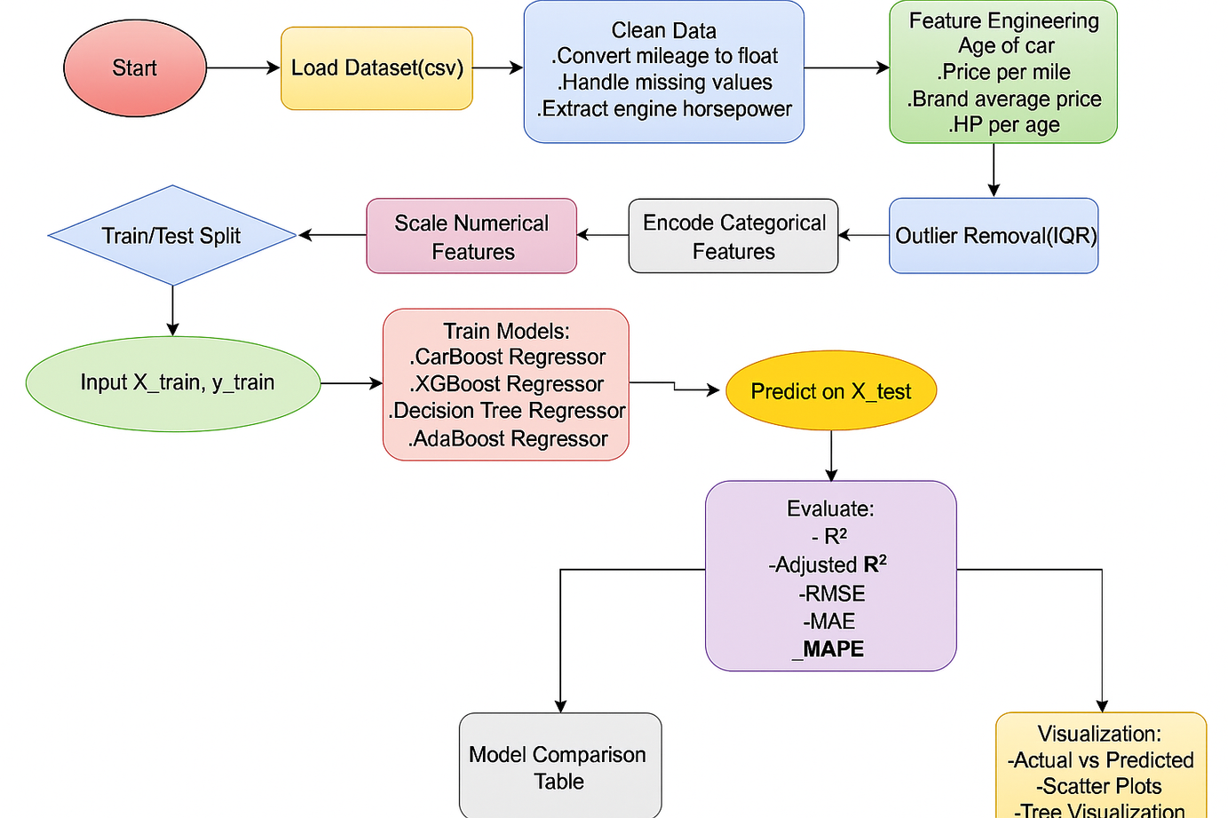
FLOW DIAGRAM
05-12-2025
Review No.2 Batch No. CG4 Department of CSE
11

Slide 11
METHODOLOGY
Dataset : used_cars.csv. The dataset was sourced from Kaggle, Indian pre-owned car listings with numerical, categorical, and boolean attributes such as price, mileage, brand, model, fuel type, transmission, and accident history.
Data Preprocessing
Outlier Removal: Used IQR method to remove extreme values in mileage, price, and engine size.
Feature Transformation: Converted text-based numeric fields and applied log₁p transformation to reduce skewness.
Encoding & Scaling: Used label encoding for categorical features and StandardScaler for numeric attributes.
05-12-2025
Review No.2 Batch No. CG4 Department of CSE
12

Slide 12
METHODOLOGY
Feature Engineering: Created domain-specific features like price-per-km, horsepower-to-age ratio, and brand average price for better prediction.
Machine Learning Models
Linear Regression: Baseline model for linear price relationships.
Decision Tree: Captures non-linear feature interactions using rule-based splits.
Random Forest: Reduces overfitting by averaging multiple decision trees.
XGBoost: Gradient boosting for improved accuracy and generalization.
CatBoost: Efficiently handles categorical data and avoids overfitting.
LightGBM: Fast, memory-efficient boosting ideal for large datasets.
Performance Metrics: R2 , RMSE, MAE,MAPE
05-12-2025
Review No.2 Batch No. CG4 Department of CSE
13

Slide 13
SYSTEM REQUIREMENTS
Software Specifications:
1. Programming Language: Python
2. Libraries/Frameworks: Scikit-learn, Pandas, NumPy, Matplotlib
3. Operating System: macOS Ventura / macOS Monterey / macOS Sonoma
4. IDE/Editor: Jupyter Notebook / PyCharm / VS Code
5. Data Source: Kaggle EyePACS Dataset (Retinal Fundus Images)
Hardware Specifications
1. Processor: Apple M1 / M1 Pro / M2 / M3 (or Intel i5/i7 Mac equivalents)
2. RAM: 16 GB Unified Memory
3. Storage: 512 GB SSD
4.GPU(Optional): Apple Silicon Integrated GPU (sufficient for most ML tasks)
5. Other: High-speed internet for dataset access and model training
05-12-2025
Review No.2 Batch No. CG4 Department of CSE
14

Slide 14
IMPLEMENTATION (PRE-PROCESSING CODE)
import pandas as pd
import numpy as np
from sklearn.model_selection import train_test_split
from sklearn.metrics import r2_score, mean_squared_error, mean_absolute_error
# ---------------------
# Load and Clean Data
# ---------------------
df = pd.read_csv("/content/drive/MyDrive/Project/Dataset/usedcars.csv").copy()
df['milage'] = (
df['milage']
.str.replace('mi.', '', regex=False)
.str.replace(',', '', regex=False)
.astype(float)
)
df['Age'] = 2025 - df['model_year']
df['clean_title'] = df['clean_title'].fillna("Unknown")
df['accident'] = df['accident'].fillna("Unknown")
df['Is_Clean_Title'] = df['clean_title'].apply(lambda x: 1 if 'Yes' in str(x) else 0)
df['Has_Accident'] = df['accident'].apply(lambda x: 0 if 'None' in str(x) else 1)
df['engine_hp'] = (
df['engine']
.str.extract(r'(\d{2,4})\.?0?HP')
.astype(float)
)
df['engine_hp'] = df['engine_hp'].fillna(df['engine_hp'].median())
# Remove outliers
for col in ['milage', 'price', 'engine_hp']:
Q1, Q3 = df[col].quantile(0.25), df[col].quantile(0.75)
IQR = Q3 - Q1
lower, upper = Q1 - 1.5 * IQR, Q3 + 1.5 * IQR
df = df[(df[col] >= lower) & (df[col] <= upper)]
df = df[(df['milage'] < 500000) & (df['price'] < 1e7) & (df['price'] > 50000)]
# Feature Engineering
# ---------------------
df['price_per_mile'] = df['price'] / (df['milage'] + 1)
df['brand_avg_price'] = df.groupby('brand')['price'].transform('mean')
df['hp_per_age'] = df['engine_hp'] / (df['Age'] + 1)
05-12-2025
Review No.2 Batch No. CG4 Department of CSE
14

Slide 15
IMPLEMENTATION
1. Development Environment
The system was implemented in Python using Google Colab for model training and VS Code for backend development. Required libraries included Pandas, NumPy, Scikit-learn, XGBoost, CatBoost, LightGBM, Matplotlib, and Flask.
2. Data Processing Implementation
Scripts were written to load the dataset, clean inconsistent values, apply IQR-based outlier removal, encode categorical variables, and scale numerical features. Feature engineering functions were implemented to compute derived attributes such as price-per-km and hp-per-age.
3. Model Training Workflow
Each machine learning model was trained and optimized using dedicated Python modules. GridSearchCV was used for hyperparameter tuning, and the final stacked ensemble model was trained using outputs from base learners. Trained models were saved using joblib.
05-12-2025
Review No.2 Batch No. CG4 Department of CSE
14

Slide 16
IMPLEMENTATION
4. Evaluation & Visualization
Residual plots, prediction comparison graphs, and feature importance charts were generated to verify performance. The stacked ensemble achieved the best accuracy and was selected for deployment.
5. Backend & API Implementation
A Flask-based REST API was developed to serve real-time predictions. The API loads the final model, accepts vehicle details via JSON, processes them through the pipeline, and returns the predicted price. CORS was enabled for frontend communication.
6. UI Integration
A simple web interface was created to capture user inputs and display predicted prices. The frontend communicates with the Flask API, enabling interactive and real-time valuation for users.
05-12-2025
Review No.2 Batch No. CG4 Department of CSE
14

Slide 17
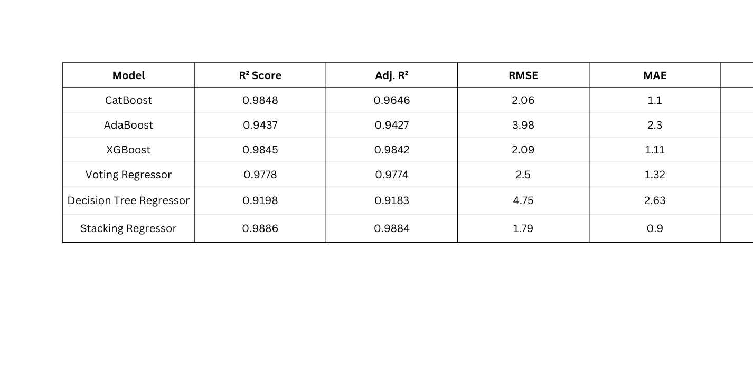
RESULTS & ANALYSIS
TABLE 5. RESULTS FOR ALL CLASSIFIERS
Stacking Regressor delivered the best overall performance with an R² of 0.9886, lowest RMSE (1.79), and MAE (0.9) — indicating high predictive accuracy and minimal error.
CatBoost and XGBoost also performed strongly (R² ≈ 0.984), showing their ability to capture non-linear market patterns effectively.
05-12-2025
Review No.2 Batch No. CG4 Department of CSE
16

Slide 18
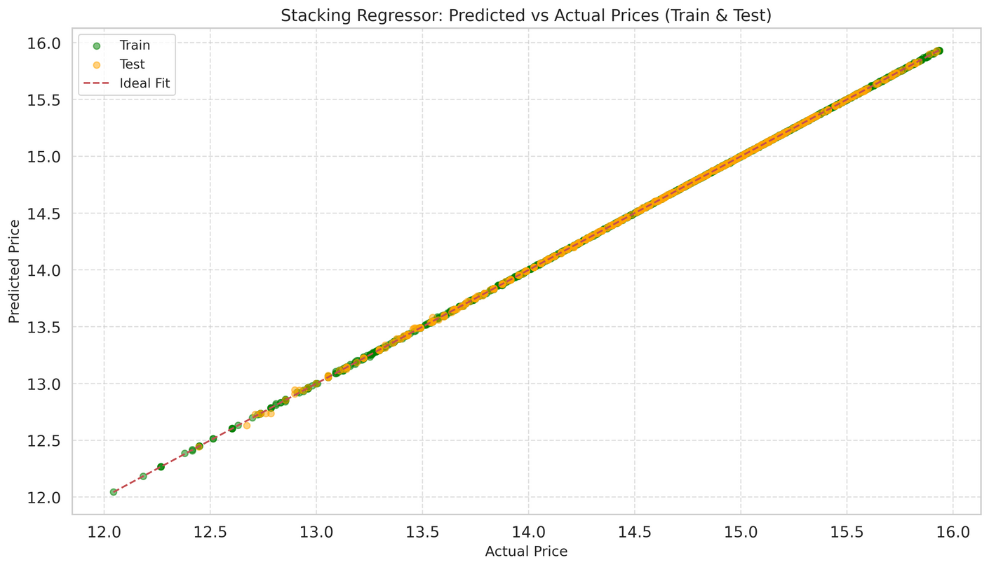
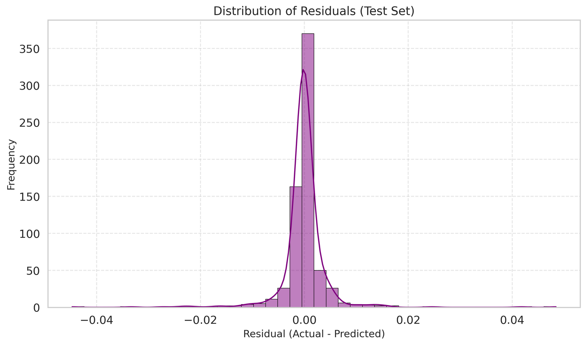
RESULTS & ANALYSIS
Fig 1. train vs test for stacking regressor
Fig 2. Residual graph for stacking regressor
05-12-2025
Review No.2 Batch No. CG4 Department of CSE
17

Slide 19
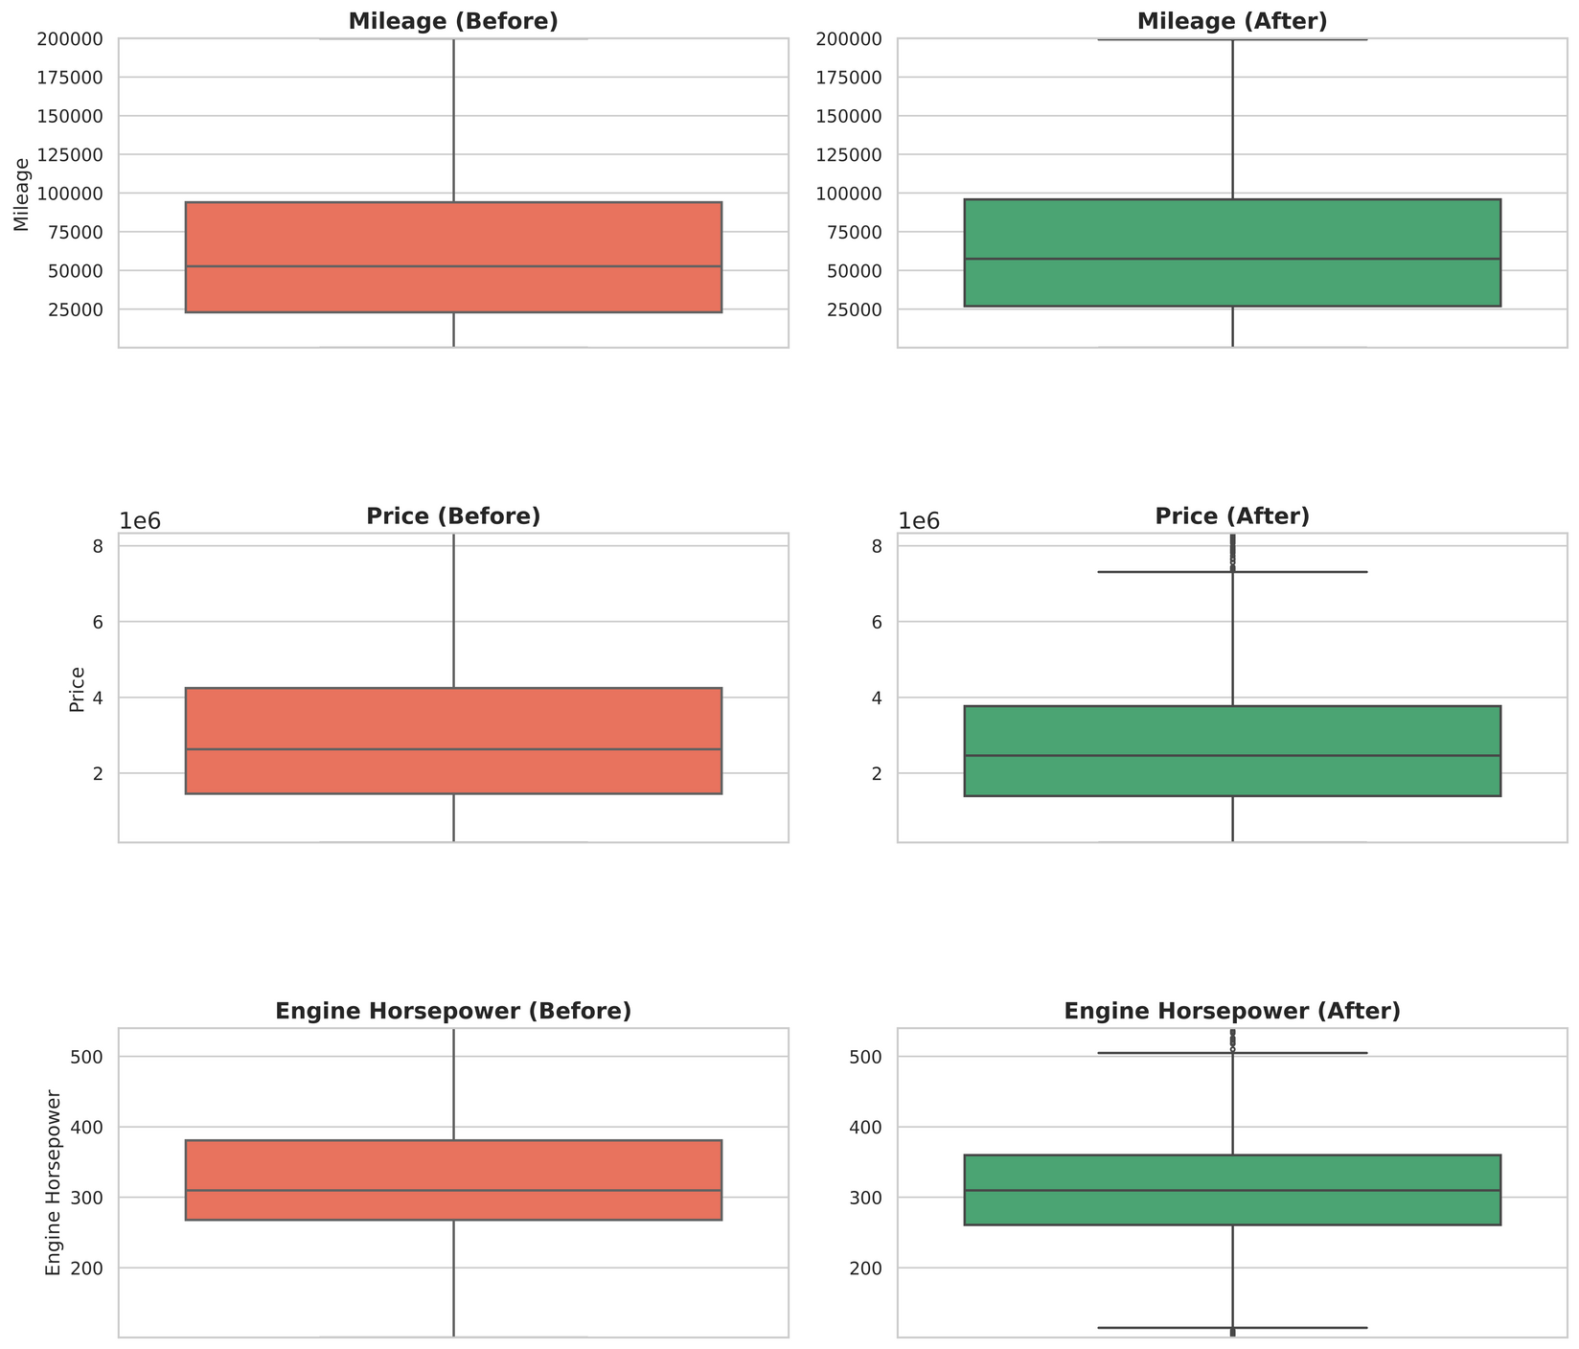
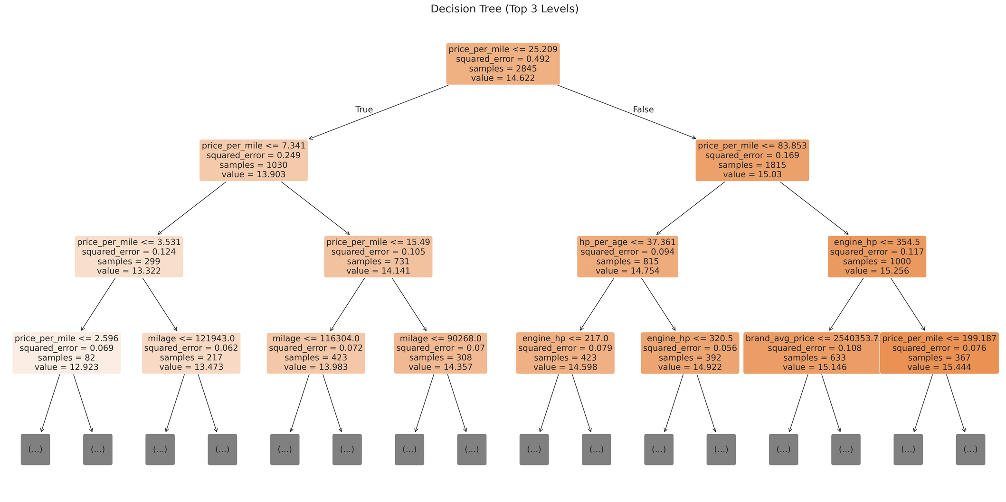
RESULTS & ANALYSIS
Fig 3. outlier comparison
Fig 4. decision tree
05-12-2025
Review No.2 Batch No. CG4 Department of CSE
18

Slide 20
CONCLUSION
Developed a machine learning-based framework for accurate prediction of pre-owned car prices in the Indian market.
Applied advanced data preprocessing and feature engineering (price-per-km, horsepower-to-age ratio, brand averages) to capture real market behavior.
Compared multiple regression models — Decision Tree, Random Forest, AdaBoost, XGBoost, CatBoost, and Stacking Regressor — using cross-validation.
The Stacking Regressor (Ridge + XGBoost + LightGBM) achieved the best performance with R² = 0.9886, RMSE = 1.79, and MAE = 0.90.
The proposed model provides a robust, scalable, and interpretable solution for real-time car valuation through a Flask-based web app.
05-12-2025
Review No.2 Batch No. CG4 Department of CSE
19

Slide 21
FUTURE SCOPE
Deep Learning Integration: Incorporate neural networks or CNNs to process car images for visual condition-based pricing.
Text & Sentiment Analysis: Use NLP techniques on car descriptions or reviews to include qualitative insights.
Dynamic Market Adaptation: Continuously update the model with live data from online marketplaces for real-time accuracy.
Explainable AI (XAI): Implement SHAP/LIME for transparency and interpretability of predictions.
Mobile & API Deployment: Extend the system to mobile apps and public APIs for widespread accessibility and integration with fintech and dealer platforms.
05-12-2025
Review No.2 Batch No. CG4 Department of CSE
20

Slide 22
REFERENCES
[1] Parishad, N., Yildirimoglu, M., & Hickman, M. (2025). Congestion pricing in multi-modal networks: An application of deep reinforce- ment learning. Transportation Research PartC: Emerging Technologies, 177,105166.(https://doi.org/10.1016/j.trc.2025.105166)
[2] Parishad, N., Yildirimoglu, M., & Hickman, M. (2025). Congestion pricing in multi-modal networks: An application of deep reinforcement learning. Transportation Research Part C: Emerging Technologies, 177, 105166.
[3] Bergmann, S., & Feuerriegel, S. (2025). Machine learning for predicting used car resale prices using granular vehicle equipment information. Expert Systems with Applications, 263, 125640.
[4] Mirascı, S., & Aksoy, A. (2025). Data-driven purchasing strategies: Price prediction models and strategy development. Expert Systems with Applications, 266, 125986.
[5] Ahaggach, H., Abrouk, L., & Lebon, E. (2024). Enhancing car damage repair cost prediction: Integrating ontology reasoning with regression models. Intelligent Systems with Applications, 23, 200411.
[6] Ahmad, M., Farooq, M. A., Hussain, M. Z., Hasan, M. Z., Mustafa, M., Khalid, A., ... & Javaid, A. (2024, April). Car price prediction using machine learning. In 2024 IEEE 9th International Conference for Convergence in Technology (I2CT) (pp. 1-5). IEEE. (https://doi.org/10.1109/I2CT61223.2024.10544124)
[7] Mühlematter, D. J., Wiedemann, N., Xin, Y., & Raubal, M. (2024). Spatially-aware station based car-sharing demand prediction. Journal of Transport Geography, 114, 103765.
[8] Farman, H., Ahmed, S., Mughal, M., Mastoi, Q., & Lalwani, G. (2025). Car price prediction and recognition using deep learning and computer vision algorithms. Sir Syed University Research Journal of Engineering & Technology, 15, 1-14.
[9] Mandys, F. (2023). Search for an affordable clean car: Pricing of conventional and clean automobiles. Transportation Research Part D: Transport and Environment, 118, 103738.
[10] Madhusudhanan, K., Mishra, A., & Agarwal, A. (2024). ProbSAINT: Probabilistic tabular regression for used car pricing. arXiv preprint arXiv:2403.03812.
05-12-2025
Review No.2 Batch No. CG4 Department of CSE
21

Slide 23
REFERENCES
[11]Rahman, M., Islam, A. S., & Nahar, N. (2023). Machine learning model for used car price prediction. In Proc. IEEE Int. Conf. Smart Technologies, vol. 2023, pp. 102–107.
[12] Carvalho, G., Viana, D., Barbosa, L., & Ren, T. I. (2023). Combining structured and unstructured data using co-attention for car price prediction. Procedia Computer Science, 222, 646-655.
[13] Mohammed, M. S., Abduljabar, A. M., Faisal, M. M., Mahmmod, B. M., Abdulhussain, S. H., Khan, W., ... & Hussain, A. (2023). Low-cost autonomous car level 2: Design and implementation for conventional vehicles. Results in Engineering, 17, 100969. (https://doi.org/10.1016/j.rineng.2023.100969)
[14] Bergmann, S., & Feuerriegel, S. (2025). Machine learning for predicting used car resale prices using granular vehicle equipment information. Expert Systems with Applications, 263, 125640. (https://doi.org/10.1016/j.eswa.2024.125640)
[15] Bejani, M. T. H., GhasemiGol, H., & Kazemi, R. (2024). Second-hand car price prediction: A novel hybrid model integrating machine learning and metaheuristic optimization. Expert Systems with Applications, 236, 121277. (https://doi.org/10.1016/j.eswa.2023.121277)
[16] Venugopal, V., & Haseena, S. (2025). Accurate price prediction of used cars using machine learning models. International Journal of Engineering Research and Science & Technology, 21, 1043-1049. (https://doi.org/10.62643/ijerst.2025.v21.i2.pp1043-1049)
[17] Li, C. (2024). Machine learning-based models for accurate car prices prediction. Highlights in Business, Economics and Management, 40, 416-421. (https://doi.org/10.54097/9zcpv779)
[18] Bergmann, S., & Feuerriegel, S. (2025). Machine learning for predicting used car resale prices using granular vehicle equipment information. Expert Systems with Applications, 263, 125640. (https://doi.org/10.1016/j.eswa.2024.125640)
[19] Nandan, M., & Ghosh, D. (2023). Pre-owned car price prediction by employing machine learning techniques. Journal of Decision Analytics and Intelligent Computing, 3(1), 167-184. (https://doi.org/10.31181/jdaic10008102023n)
[20] Farman, H., Ahmed, S., Mughal, M. H., & Lalwani, G. S. (2025). Car price prediction and recognition using deep learning and computer vision algorithms. Sir Syed University Research Journal of Engineering & Technology, 15(1), 1-14. (https://doi.org/10.33317/ssurj.647)
[21] Used Car Price Prediction Dataset. Kaggle. Available: https://www.kaggle.com/datasets/taeefnajib/used-car-price-prediction-dataset/data
05-12-2025
Review No.2 Batch No. CG4 Department of CSE
22

Slide 24

QUESTIONS and ANSWERS
05-12-2025
Review No.2 Batch No. CG4 Department of CSE
23

Slide 25

ACKNOWLEGEMENTS
05-12-2025
Review No.2 Batch No. CG4 Department of CSE
24

